Slide 1

Tricky Words

Slide 2
Teacher’s note: Given the age of some of your students I have made this as simple as possible. However as some (for example) will not even be aware of the past tense in their own language, while others will understand yesterday, last week etc. it is up to you to adapt your lesson accordingly.
I strongly recommend that you read ahead and try to anticipate any issues before you encounter them in class, but please remember that some of the tricky words will simply be beyond them. Barry.

Slide 3

I
Notes:
Tricky word “I” covered in the Jolly Phonics computer program, JP 1 /sh/

Slide 4
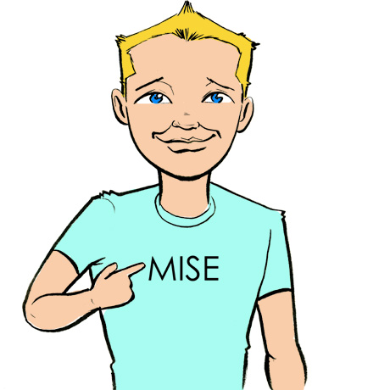
I
=
/ie/
I

Slide 5
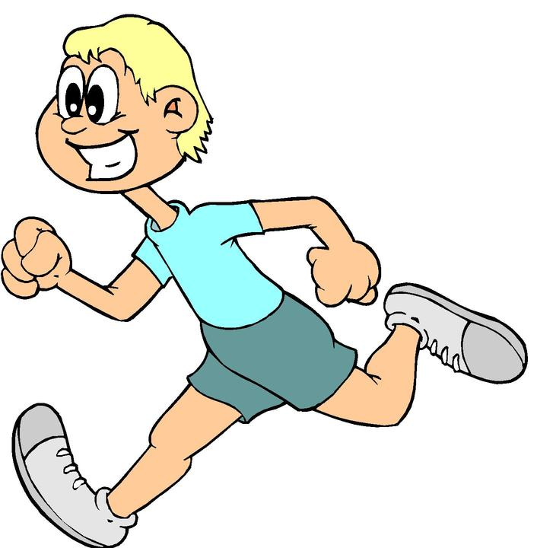
I
run
I
/ie/
/r/
/u/
/n/
I
=
/ie/

Slide 6
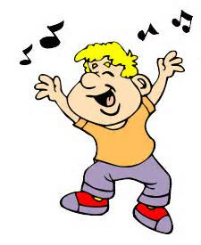
I
sing
I
/ie/
/s/
/i/
/ng/
I
=
/ie/

Slide 7
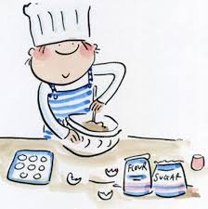
I
cook
I
/ie/
/c/
/oo/
/k/
I
=
/ie/

Slide 8
he
Notes:
Tricky word “he” covered in the Jolly Phonics computer program, JP 1 /qu/

Slide 9
he
he
=
/h//ee/

Slide 10
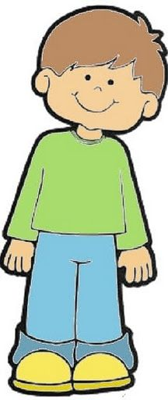

he
=
/h//ee/
he
he
=
/h//ee/

Slide 11
he
runs
he
/h//ee/
/r/
/u/
/n/
/z/
he
=
/h//ee/

Slide 12
he
sings
he
/h//ee/
/s/
/i/
/ng/
/z/
he
=
/h//ee/

Slide 13
he
cooks
he
/h//ee/
/c/
/oo/
/k/
/s/
he
=
/h//ee/

Slide 14
she
Notes:
Tricky word “she” covered in the Jolly Phonics computer program, JP 1 /qu/

Slide 15
she
she
=
/sh//ee/

Slide 16
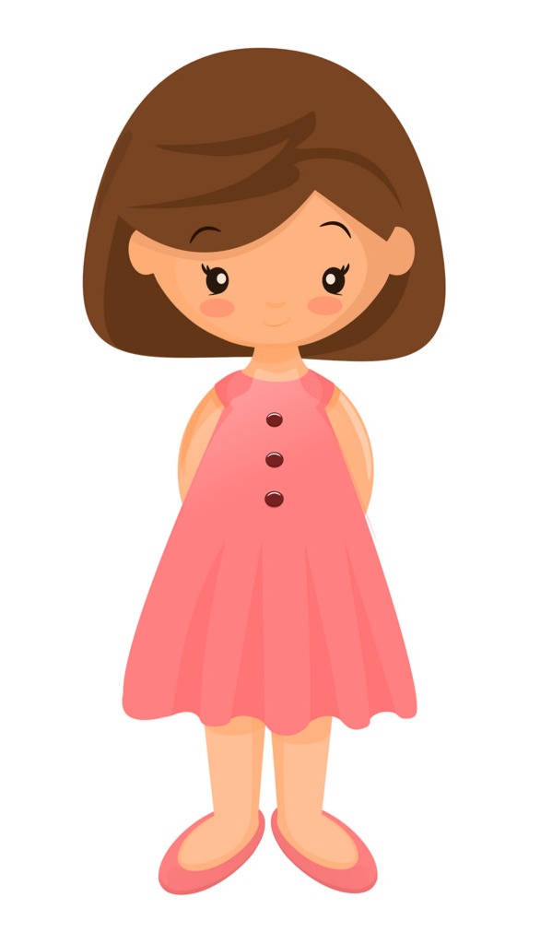
she
=
/sh//ee/
she
she
=
/sh//ee/

Slide 17
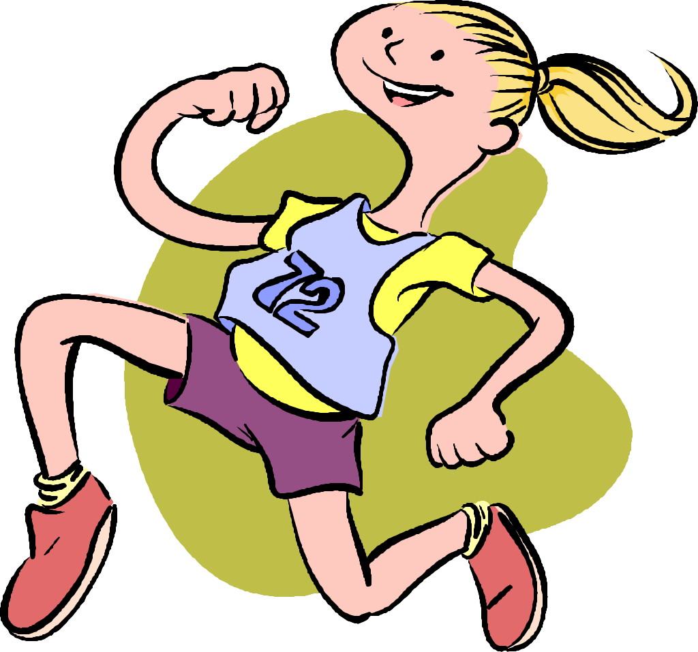
she
runs
she
/sh//ee/
/r/
/u/
/n/
/z/
she
=
/sh//ee/

Slide 18

she
sings
she
/sh//ee/
/s/
/i/
/ng/
/z/
she
=
/sh//ee/

Slide 19
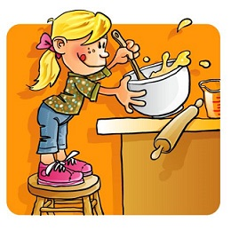
she
cooks
she
/sh//ee/
/c/
/oo/
/k/
/s/
she
=
/sh//ee/

Slide 20
we
Notes:
Tricky word “we” covered in the Jolly Phonics computer program, JP 1 /ou/

Slide 21
we
we
=
/w//ee/

Slide 22

we
=
/w//ee/
we
we
=
/w//ee/

Slide 23
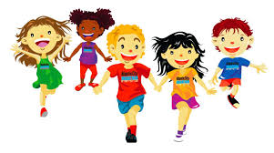
we
run
we
/w//ee/
/r/
/u/
/n/
we
=
/w//ee/

Slide 24

we
sing
we
/w//ee/
/s/
/i/
/ng/
we
=
/w//ee/

Slide 25
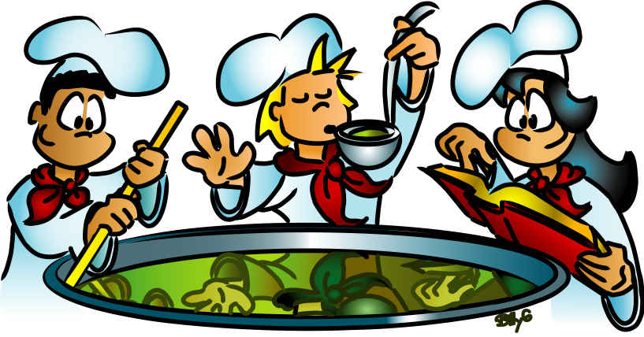
we
cook
we
/w//ee/
/c/
/oo/
/k/
we
=
/w//ee/

Slide 26
I
Notes:
I is covered in Jolly Phonics 1: /sh/

Slide 27
I
=
/ie/
I

Slide 28
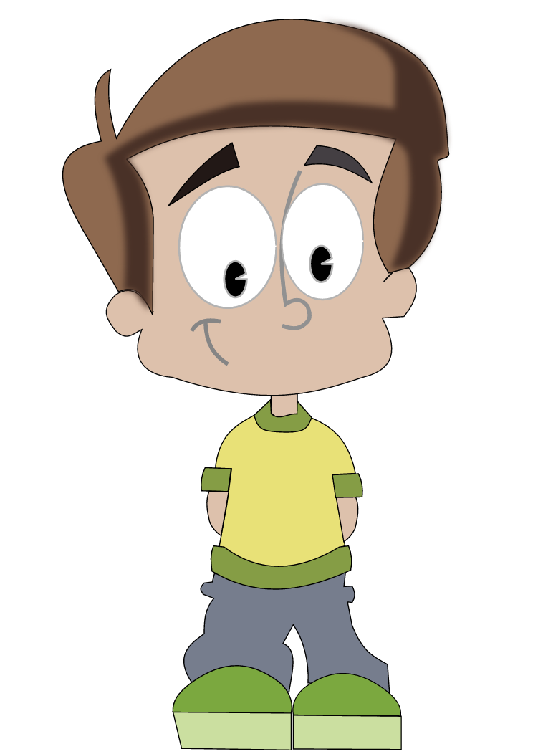
I
I
=
/ie/
I
am
tall
/ie/
/a/
/m/
/t/
all

Slide 29
I
I
=
/ie/
I
am
short
/ie/
/a/
/m/
/sh/
/or/
/t/

Slide 30
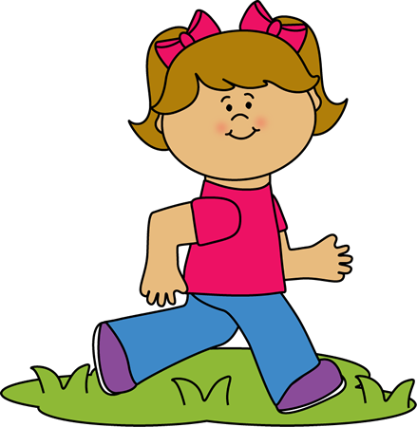
I
I
=
/ie/
I
am
fast
/ie/
/a/
/m/
/f/
/a/
/s/
/t/

Slide 31
I
I
=
/ie/
I
am
slow
/ie/
/a/
/m/
/s/
/l/
/oa/

Slide 32

I
I
=
/ie/
I
am
happy
/ie/
/a/
/m/
/h/
/a/
/p/
/ee/

Slide 33

I
I
=
/ie/
I
am
sad
/ie/
/a/
/m/
/s/
/a/
/d/

Slide 34
he
Notes:
he and she are covered in Jolly Phonics 1: /qu/

Slide 35
he
he
=
/h//ee/

Slide 36
he
=
/h//ee/
he
he
=
/h//ee/

Slide 37
he
he
=
/h//ee/
He
is
tall
/h/ /ee/
/i/
/z/
/t/
all

Slide 38
he
he
=
/h//ee/
He
is
short
/h/ /ee/
/i/
/z/
/sh/
/or/
/t/

Slide 39

he
he
=
/h//ee/
He
is
fast
/h/ /ee/
/i/
/z/
/f/
/a/
/s/
/t/

Slide 40
he
he
=
/h//ee/
He
is
slow
/h/ /ee/
/i/
/z/
/s/
/l/
/oa/

Slide 41
he
he
=
/h//ee/
He
is
happy
/h/ /ee/
/i/
/z/
/h/
/a/
/p/
/ee/

Slide 42
he
he
=
/h//ee/
He
is
sad
/h/ /ee/
/i/
/z/
/s/
/a/
/d/

Slide 43
she
Notes:
He and she are covered in Jolly Phonics 1: /qu/

Slide 44
she
she
=
/sh//ee/

Slide 45
she
=
/sh//ee/
she
she
=
/sh//ee/

Slide 46
she
she
=
/sh//ee/
She
is
tall
/sh/ /ee/
/i/
/z/
/t/
all

Slide 47
she
she
=
/sh//ee/
She
is
short
/sh/ /ee/
/i/
/z/
/sh/
/or/
/t/

Slide 48
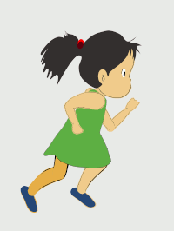
she
she
=
/sh//ee/
She
is
fast
/sh/ /ee/
/i/
/z/
/f/
/a/
/s/
/t/

Slide 49
she
she
=
/sh//ee/
She
is
slow
/sh/ /ee/
/i/
/z/
/s/
/l/
/oa/

Slide 50
she
she
=
/sh//ee/
She
is
happy
/sh/ /ee/
/i/
/z/
/h/
/a/
/p/
/ee/

Slide 51
she
she
=
/sh//ee/
She
is
sad
/sh/ /ee/
/i/
/z/
/s/
/a/
/d/

Slide 52
we
Notes:
We is covered in Jolly Phonics 1: /ou/

Slide 53
we
we
=
/w//ee/

Slide 54
we
=
/w//ee/
we
we
=
/w//ee/

Slide 55
we
we
=
/w//ee/
We
are
tall
/w/ /ee/
/ar/
/t/
all

Slide 56
we
we
=
/w//ee/
We
are
short
/w/ /ee/
/ar/
/sh/
/or/
/t/

Slide 57
we
we
=
/w//ee/
We
are
fast
/w/ /ee/
/ar/
/f/
/a/
/s/
/t/

Slide 58
we
we
=
/h//ee/
We
are
slow
/w/ /ee/
/ar/
/s/
/l/
/oa/

Slide 59
we
we
=
/w//ee/
We
are
happy
/w/ /ee/
/ar/
/h/
/a/
/p/
/ee/

Slide 60
we
we
=
/w//ee/
We
are
sad
/w/ /ee/
/ar/
/s/
/a/
/d/

Slide 61
the
Notes:
Tricky word “the” covered in the Jolly Phonics computer program, JP 1 /th/

Slide 62
the
the
=
/th//u/

Slide 63

the
dog
the
/th//u/
/d/
/o/
/g/
the
=
/th//u/

Slide 64

the
cat
the
/th//u/
/c/
/a/
/t/
the
=
/th//u/

Slide 65

the
pig
the
/th//u/
/p/
/i/
/g/
the
=
/th//u/

Slide 66
be
be
=
/b//ee/
Notes:
Tricky word “be” covered in the Jolly Phonics computer program, JP 1 /oi/

Slide 67

be
be
=
/b//ee/

Slide 68
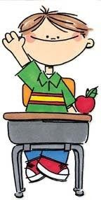

be
be
=
/b//ee/
be
good
/b/ /ee/
/g/
/oo/
/d/

Slide 69


be
be
=
/b//ee/
be
quiet
/b/ /ee/
/qu/
/ie/
/e/
/t/

Slide 70
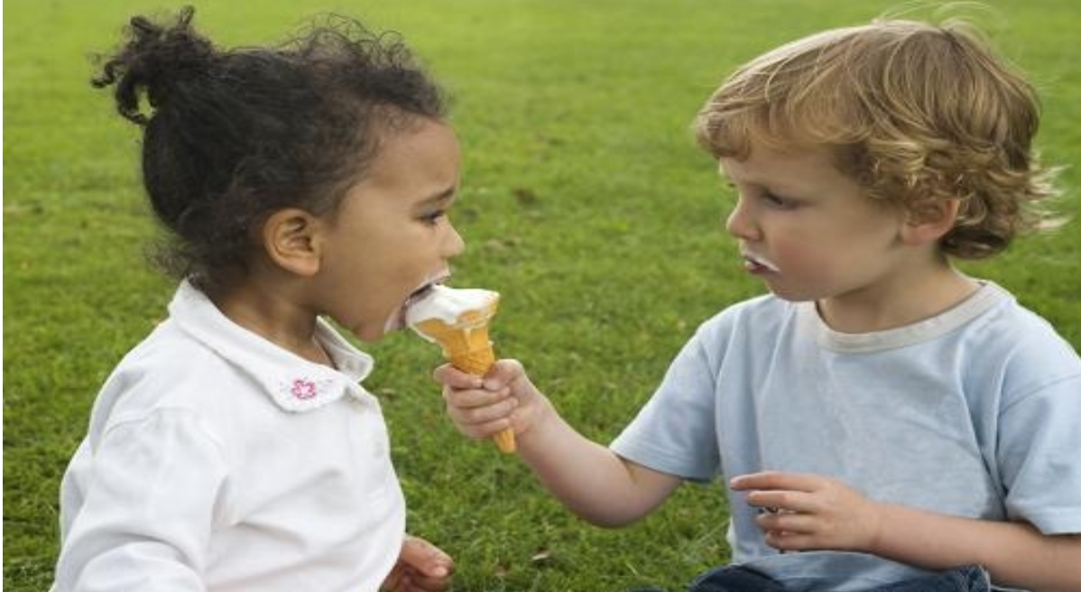
be
be
=
/b//ee/
be
kind
/b/ /ee/
/k/
/ie/
/n/
/d/

Slide 71
was
was
=
/w//o//z/
Notes:
Tricky word “was” covered in the Jolly Phonics computer program, JP 1 /ue/

Slide 72
was
now
past
am
was
was
is
=
/w//o/ /z/

Slide 73
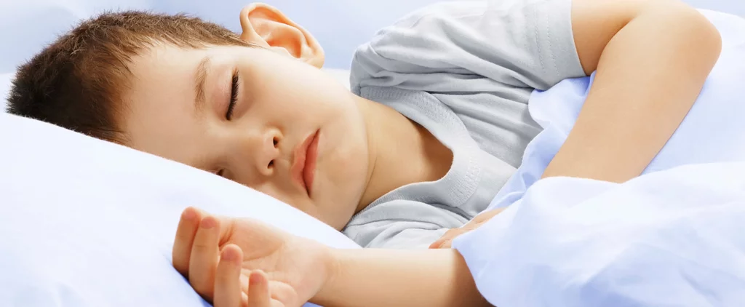
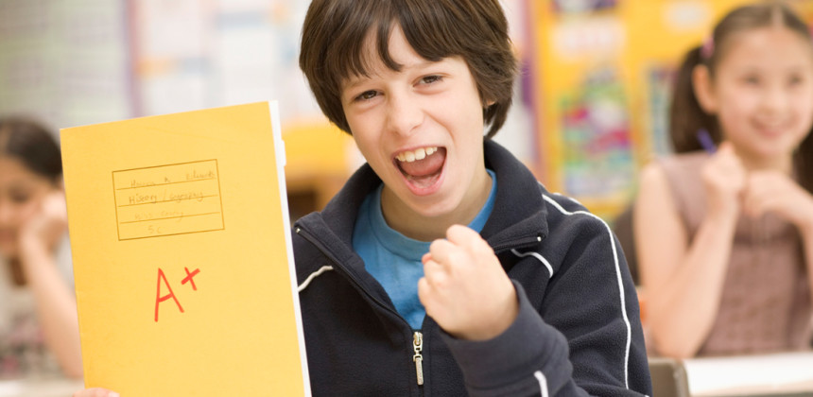
past
now
I
I
am
at home.
at school.
was
He
He
is
was
was
=
/w//o/ /z/

Slide 74
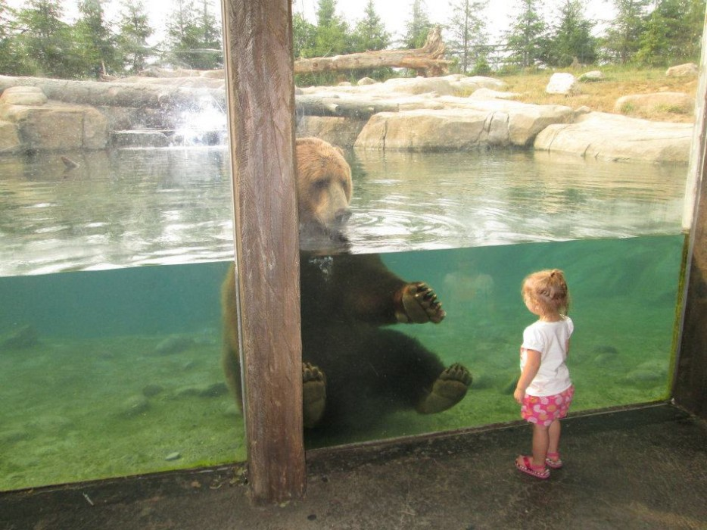
past
now
I
I
am
at the zoo.
at school.
was
She
He
is
was
was
=
/w//o/ /z/

Slide 75
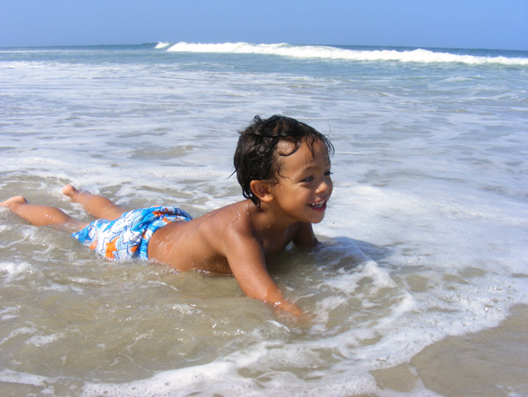
past
now
I
I
am
at the beach.
at school.
was
He
He
is
was
was
=
/w//o/ /z/

Slide 76
to
to
=
/t//oo/
Notes:
Tricky word “to” covered in the Jolly Phonics computer program, JP 1 /er/

Slide 77
to
to
to
=
/t//oo/

Slide 78


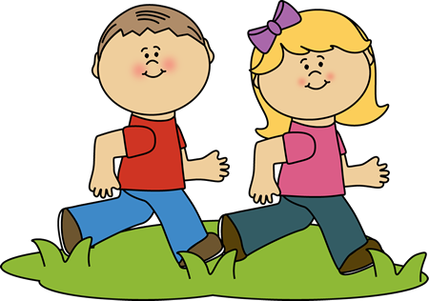
to
to
=
/t//oo/
Go
to
class
/g//oa/
/t//oo/
/c/
/l/
/a/
/s/

Slide 79
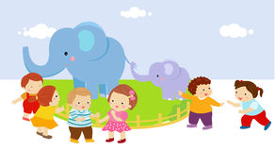
to
to
=
/t//oo/
Go
to
the
zoo
/g//oa/
/t//oo/
/th/ /u/
/z/
/oo/

Slide 80
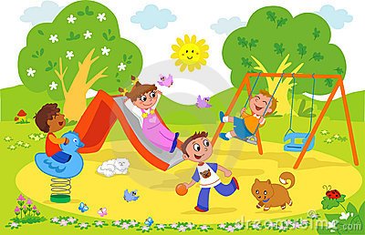
to
to
=
/t//oo/
Go
to
the
park
/g//oa/
/t//oo/
/th/ /u/
/p/
/ar/
/k/

Slide 81
do
do
=
/d//oo/
Notes:
Tricky word “do” covered in the Jolly Phonics computer program, JP 1 /er/

Slide 82

do
Do
you?
/d//oo/
/ue/
do
=
/d//oo/

Slide 83

Do
you?
/d//oo/
/ue/
do
Yes
I
do
/y//e/ /s/
/ie/
/d//oo/
do
=
/d//oo/

Slide 84
Do
you?
do
/d//oo/
/ue/
No
I
do
not
/n//oa/
/ie/
/d//oo/
/n//o//t/
do
=
/d//oo/

Slide 85
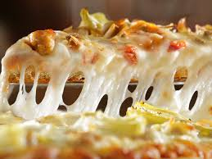
do
do
=
/d//oo/
Do
you
like
pizza?
/d//oo/
/ue/
/l/
/ie/
/k/
/p/ /ee/ /t/ /s/ /a/

Slide 86
do
do
=
/d//oo/
Do
you
like
pizza?
Yes
I
do
/y//e/ /s/
/ie/
/d//oo/

Slide 87
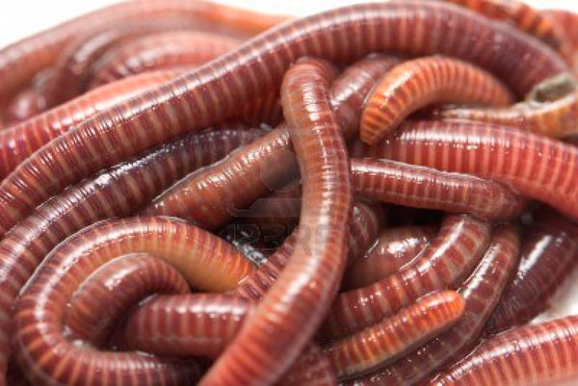
do
do
=
/d//oo/
Do
you
like
worms?
/d//oo/
/ue/
/l/
/ie/
/k/
/w/ /er/ /m/ /z/

Slide 88
do
do
=
/d//oo/
Do
you
like
worms?
No
I
do
not
/n//oa/
/ie/
/d//oo/
/n//o//t/

Slide 89
all
Notes:
We is covered in Jolly Phonics 1: /ou/

Slide 90
all
all
=
/or/ /l/

Slide 91




all
all
=
/or/ /l/
ball
b
b
b
all
/b/
/or/
/l/

Slide 92

all
all
=
/or/ /l/
fall
f
all
/f/
/or/
/l/

Slide 93

all
all
=
/or/ /l/
wall
w
all
/w/
/or/
/l/

Slide 94
all
all
=
/or/ /l/
ball
call
fall
gall
hall
mall
pall
tall
wall

